Slide 1
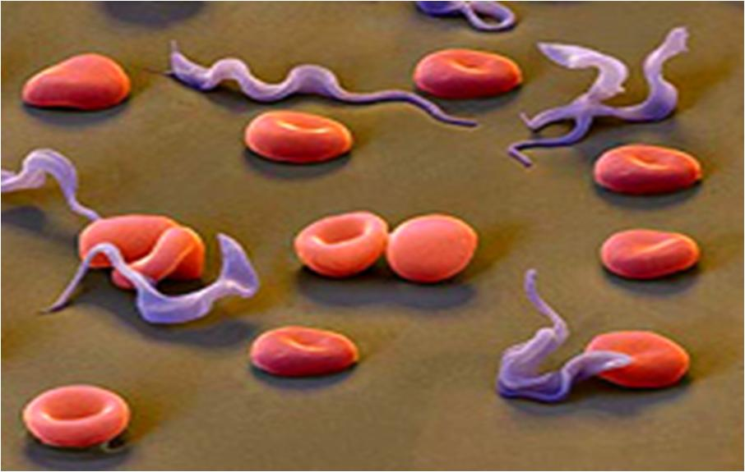
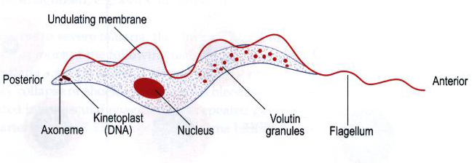
Trypanosomes
Trypanosomes are flagellated protozoa,
trypomastigote in shape, with elongated body,
central nucleus,
posterior kinetoplast,
long undulating membrane
and anterior free flagellum.

Slide 2
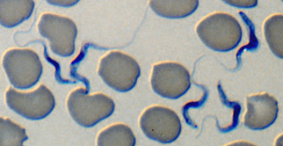
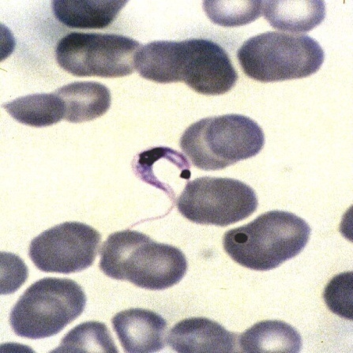
Classification
1- Polymorphic trypanosomes
= African Trypanosomiasis
The parasite has different size & shape in blood
e.g.
T. brucei complex:
a] T. brucei gambiense &
b] T. brucei rhodesiense
2- Monomorphic trypanosomes
American Trypanosomiasis
The parasite has the same size & shape in blood
e.g.
T. cruzi
Polymorphic trypanosomes
Monomorphic trypanosomes

Slide 3
Trypanosomiasis
Parasitic diseases caused by the
Haemo-somatic flagellates Trypanosoma.
There are 2 main forms:
[1] African Trypanosomiasis [Sleeping sickness]:
caused by T. brucei transmitted by Glossina species (Tsetse fly).
[2] American trypanosomiasis [Chagas’ disease]:
caused by T. cruzi and transmitted by (winged bug).

Slide 4
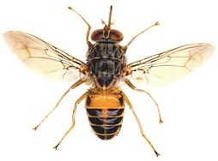
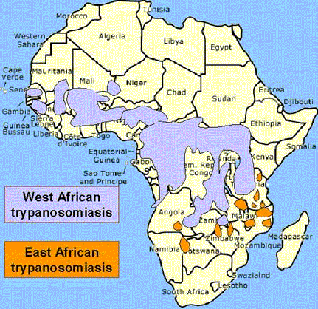
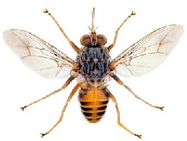
African Trypanosomiasis [Sleeping Sickness]
Geographical distribution: corresponds to that of the vector which is approximately 20° N & 20° S of the equator
Glossina
Both male & female
Glossina
Tse tse fly
Annual cases estimated in 50.000–70.000:

Slide 5
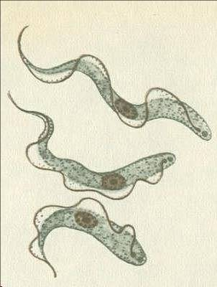
Morphology ==
Trypanosome has 3 forms in vertebrate host
Characters | Morphological form
30 u in length, with a free flagellum& actively motile | 1- Long slender form
22 u in length, with a short free flagellum | 2- Intermediate form
15 u in length, without a free flagellum & sluggish | 3- Short stumpy form
Trypanosome in vector
Metacyclic form in salivary gland

Slide 6
Life cycle of African trypanosomiasis

Slide 7
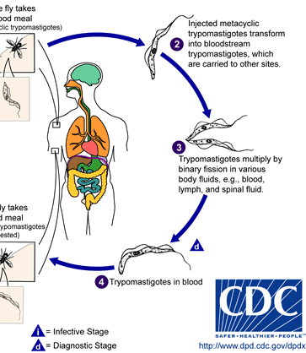
Life cycle; in vertebrate host
1- Infected tsetse fly bites a host to take a blood meal & inoculates metacyclic trypomastigotes with saliva into the bite wound.
2- The organisms rapidly transform into bloodstream trypomastigotes which are carried to other sites.
3- Trypomastigotes multiply by binary fission in various body fluids e.g. blood, lymph, spinal fluid)
4- Parasites spread via blood to lymphatic system and CNS.

Slide 8
Life cycle; in vector
1- The tsetse fly takes blood meal from an infected host containing bloodstream trypomastigotes.
2- In the midgut of the fly, bloodstream trypomastigotes transform to short stumpy form metacyclic trypomastigotes (Infective stage).
3- The cycle inside the vector takes about 3 weeks.

Slide 9
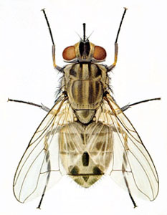
Habitat
Mode of infection
During the early stages of the disease;
Trypanosomes are found extracellular in the peripheral blood, lymph, tissue spaces of various organs of R.E.S. [Liver, Lymph nodes, Bone marrow, Spleen].
In the terminal stages; Trypanosomes are found in Central Nervous System.
1- Anterior station transmission, inoculative or Salivarian: Bite of infected Glossina [tse tse fly], where the metacyclic trypomastigotes are introduced with saliva into the puncture wound made by the fly.
2- Mechanical transmission: by Glossina or other blood sucking flies [Stomoxys: Stable fly].
3- Blood transfusion.
4- Organ transplantation

Slide 10
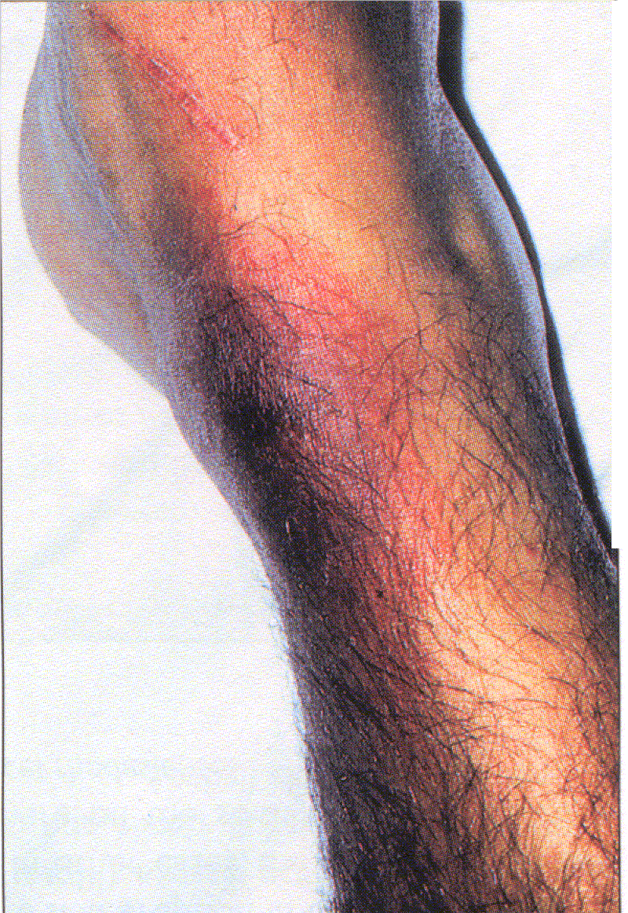
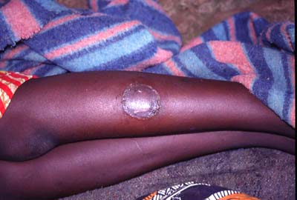
Pathogenesis & Clinical picture of African trypanosomiasis
Incubation period: 1-3 weeks
1- Trypanosoma chancre [skin]
Trypomastigotes multiply at the site of bite >>>
a local inflammatory nodule
[Painful, red, may or may not ulcerate].

Slide 11
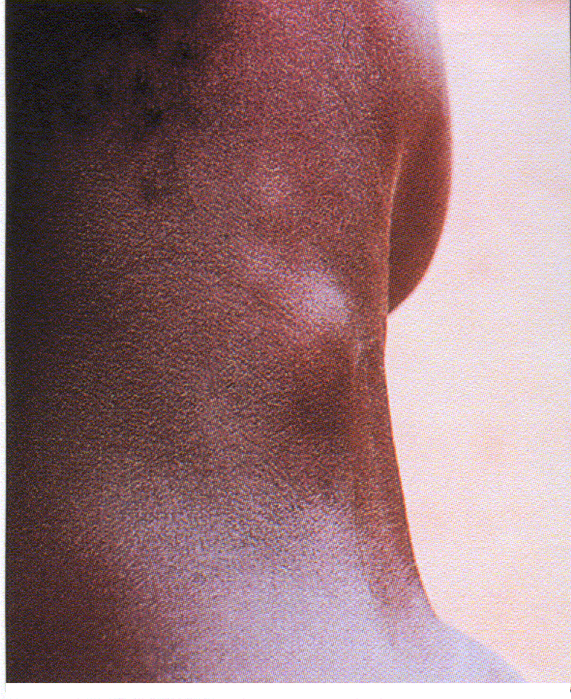
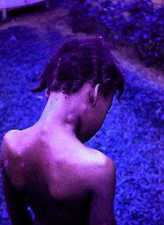
2- Haemolymphatic stage [Blood & Lymph nodes]
Trypomastigotes invade blood & lymphatic system and multiply producing Toxic manifestations & Lymphocytic hyperplasia.
Toxic manifestations: Patient gets irregular fever, headache, joint & muscle pain and rash.
Lymphocytic hyperplasia: enlarged liver & spleen, generalized lymphadenopathy especially in posterior triangle of neck “Winter bottom sign”
Bone Marrow affection: Pancytopenia.

Slide 12
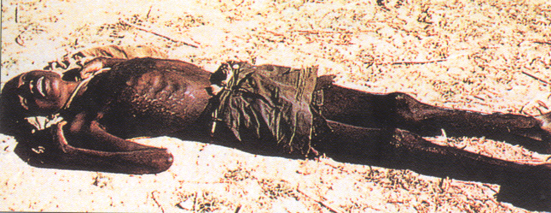
3- Meningoencephalitis stage [CNS] (Sleeping sickness stage)
By end of 1st year; Trypomastigotes invade CNS >>
perivascular infiltration of cerebral vessel with chronic inflammatory cells >> ischaemia & haemorrhage >> Meningoencephalitis & Meningomyelitis.
Patient suffers of: Severe headache, mental apathy, slow speech, tremors, involuntary movements & convulsions.
Sleeping stage develops >> Coma & death [from the disease or from intercurrent infections as pneumonia].
Coma before death

Slide 13
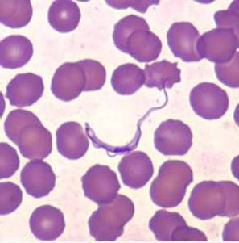
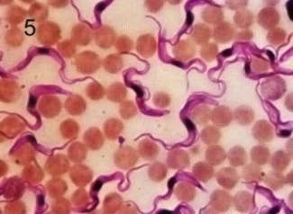
Clinical features of Gambian and Rhodesian disease are similar, but they vary in severity and duration:
Gambian Sleeping sickness
[T. gambiense ]
Parasite: Less virulent
Disease Progresses slowly; Chronic
Parasite in blood: Scanty [Low parasitaemia.
Typical sleeping sickness symptoms.
Animal inoculation: Refractory
Rhodesian Sleeping Sickness
[T. rhodesiense ]
Extreme virulence
Progresses rapidly. Acute
Plenty [High parasitaemia].
Usually fatal before sleeping sickness symptoms appear.
Susceptible with posterior-nuclear shift.

Slide 14
Diagnosis of African trypanosomiasis
I- Clinical diagnosis
History
Fever especially if associated with enlarged lymph nodes
Residence or traveling to endemic area.
Clinical picture.
II- Laboratory Diagnosis
Direct.
Indirect.

Slide 15
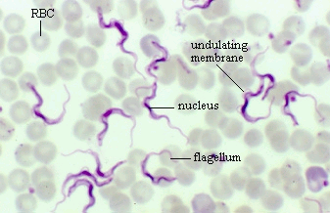
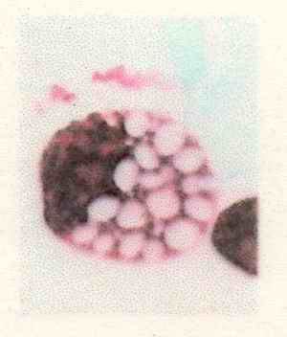
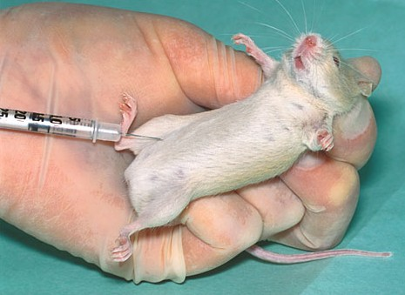
Direct Laboratory Diagnosis
To demonstrate the parasite
early from from chancre aspirate , blood, lymph node, bone marrow]
late [in CSF] BY
Microscopic examination of fresh unstained or Giemsa stained films: polymorphic trypomastigote.
b) Culture (NNN media: >>> epimastigote.
c) Animal inoculation: Animals inoculation with infected materials>>> polymorphic trypomastigote.
d) CSF examination: Trypomastigotes, increase cell count, increase IgM, lymphocytes and Morula cells which is a vacuolated plasma cell.
==
Morula cell of Mott
Notes:
No of cells increases from 15-500/cubic ml. normal 2-3/ml. ,

Slide 16
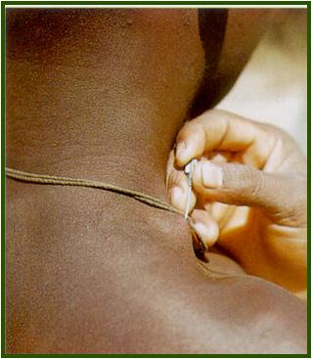
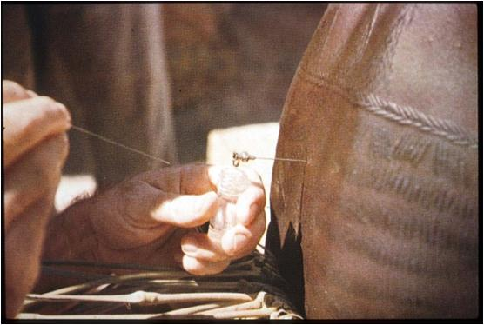
Diagnosis
Aspiration of swollen gland
Lumber puncture for CSF

Slide 17
Indirect Laboratory diagnosis
==
Detecting anti-Trypanosoma Abs by serological methods (ELISA, IFA, IHA etc..).
But, can't distinguish between current and previous infections.
Card Agglutination Trypanosomiasis Test [CATT]: It is a simple & rapid test for detection of circulating antigens in the blood of the patient. It is useful in surveys specially.
Other methods:
Molecular techniques (e.g. PCR).

Slide 18
How can African trypanosomes evade the host immune system?
Antigenic Variation
Parasite’s surface is coated with a layer of glycoprotein called Variable Surface Glycoprotein “VSG” - coat protein -.
After infection, the host evokes an immune mechanism against Parasite’s surface coat protein [VSG].
The parasite changes this surface glycoprotein to protect the underlying surface membrane from the host’s defence mechanisms.
New populations of parasites with different coat proteins appear >>> can not be recognized >>> and can not be attacked by the immune factors specific to the previous generation

Slide 19
Treatment
Prevention
& control
Early
1- Suramin (Antrypol): I.V. injection of 1 gram for 5 doses; on days 1,3,7,14 & 21
Late
(drugs that pass CNS barrier)
1-Tryparsamide: 2-4 gm I.V. injection for 10 doses.
2- Melarsoprol (Mel B): A single daily I.V. injection of 3.6 mg/kg for 3 days & repeated after 2 weeks.
1- Protection by skin repellents.
2- Treatment of patients.
3- Control of Glossina (vector).
4- Chemoprophylaxis in endemic areas
[Pentamidine at
4-6 months intervals].
No vaccine

Slide 20
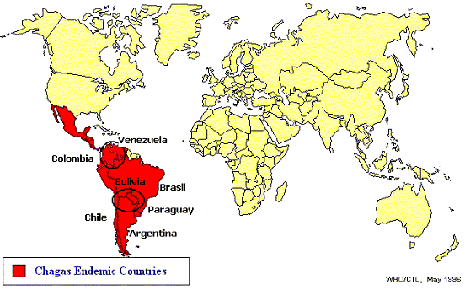
[2] Trypanosoma cruzi [Chagas Disease]
Disease: American trypanosomiasis or Chagas’ disease.
Habitat: Blood, Reticulo-endothelial cells & Muscle fibers (e.g. heart).
D.H.: Man.
R.H.: Armadillos, dogs, cats & rodents.
Epidemiology
Geographical Distribution:
Central & South America.
Mortality rate: 30%.

Slide 21
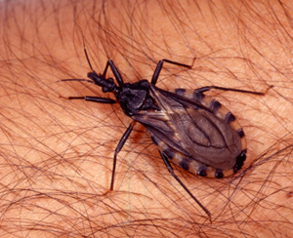
Vector: Triatoma (winged bug) or kissing bug
Transmission: Cyclopropagative transmission.
Infective stage: Metacyclic trypomastigotes.
Mode of transmission
Contamination of bite wound, skin abrasion or mucous membrane by faeces of infected vector; (Posterior station transmission)
may be transmitted by
- blood transfusion,
- organ transplantation &
- congenitally.

Slide 22
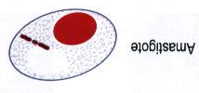
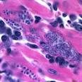
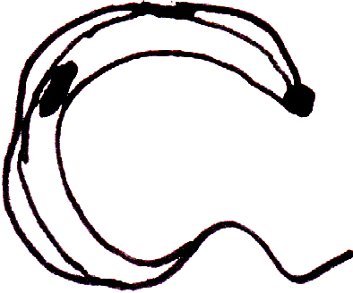
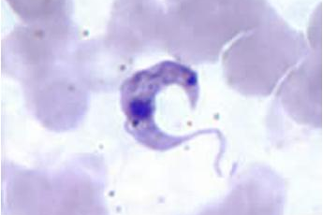
Morphology
1. Two forms in man
a- Amastigote (multiplying form):
intracellular in cardiac muscle & other tissues [smooth muscle cells, glial cells of brain & macrophage] in small groups or cyst collections.
b- Trypomastigote (none multiplying form):
in blood, monomorphic, 20µ in length & few, C or U shape with short undulating membrane and large sub terminal kinetoplast.

Slide 23
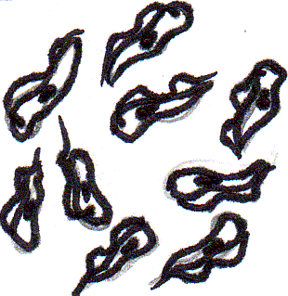
Morphology [Cont.]
forms in the vector
Metacyclic or short stumpy trypanosomes
(infective stage)
in hindgut and stool.

Slide 24
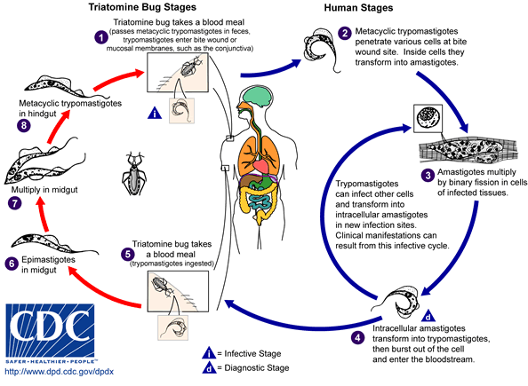
Life cycle of Trypanosoma cruzi

Slide 25
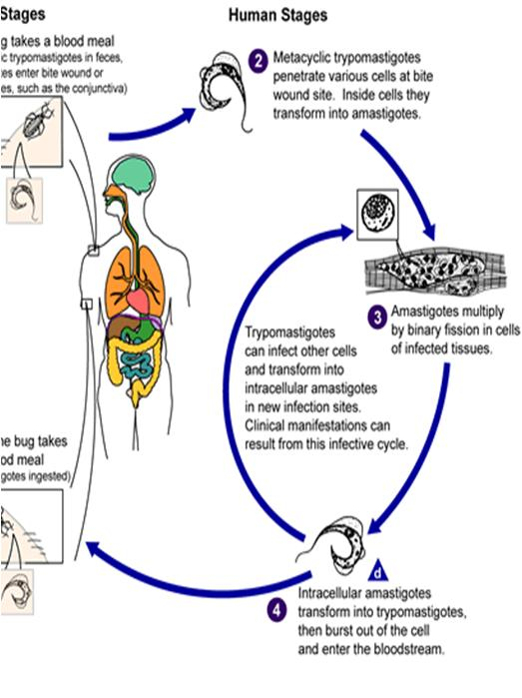
Life cycle; in vertebrate host
Infected triatomine releases metacyclic trypomastigotes in feces nearby the site of bite. The host; by scratching; rubs the parasites into the wound or onto mucosal membranes (conjunctiva...).
Trypanosomes gain subcutaneous skin cells, pass into blood stream & invade a variety of host cells (e.g. RES cells, myocardium, muscles, nervous system) where they convert into dividing amastigotes.
Released amastigotes will transform within the interstitial spaces into trypanomastigotes (C-shape) prior to entering the blood stream.

Slide 26
Life cycle in; Vector
5- When vector bites an infected host, it sucks blood containing C-shaped monomorphic trypomastigotes.
6- In midgut, the parasites change to change to metacyclic trypomastigotes.
7- The cycle in vector takes about 10 days.

Slide 27
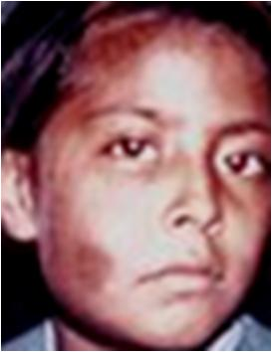
Pathogenesis & clinical picture
Chagas’ disease has an acute and a chronic phase:
Acute Chagas’ disease
It is more common in infants & children.
1-Primary lesion (Chagoma)
At the site of bite, parasites multiply inside macrophages >>> erythematous cutaneous indurated areas which is more common on the face.

Slide 28
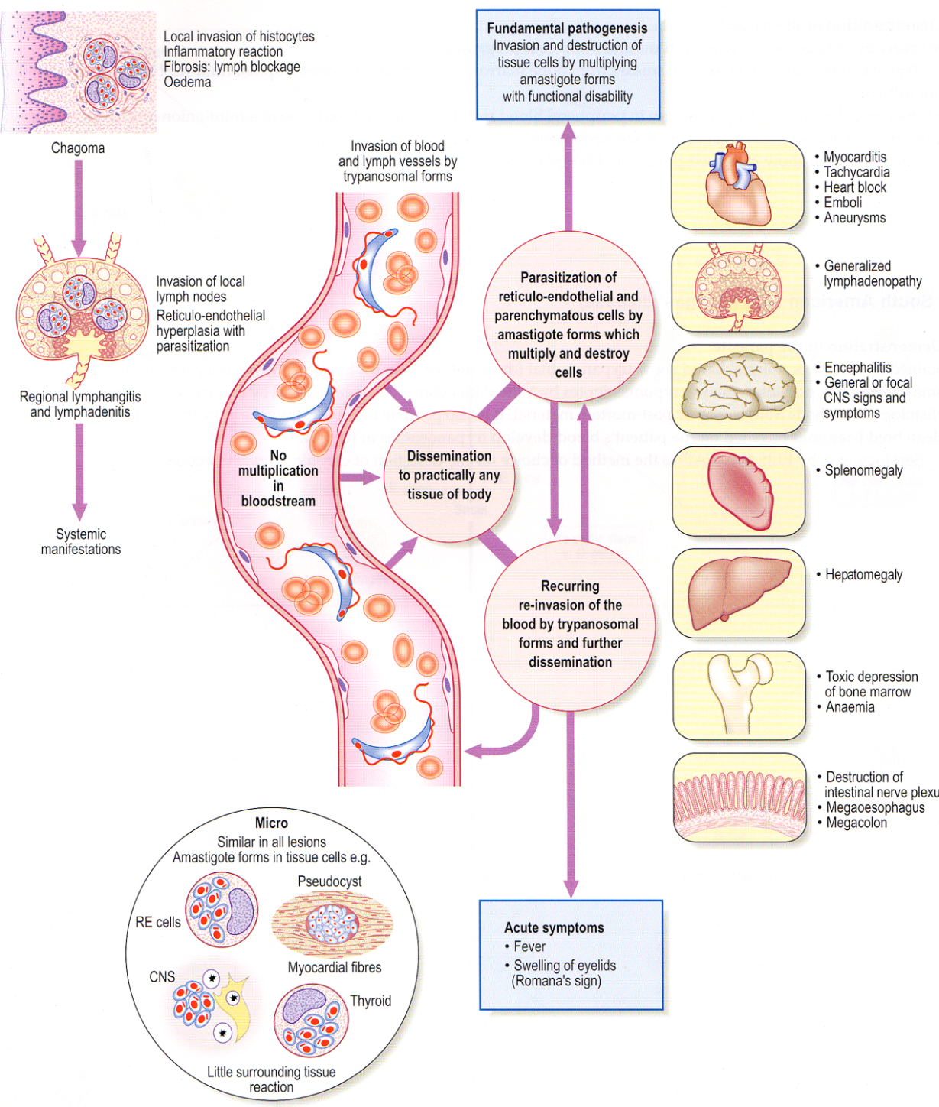

Slide 29
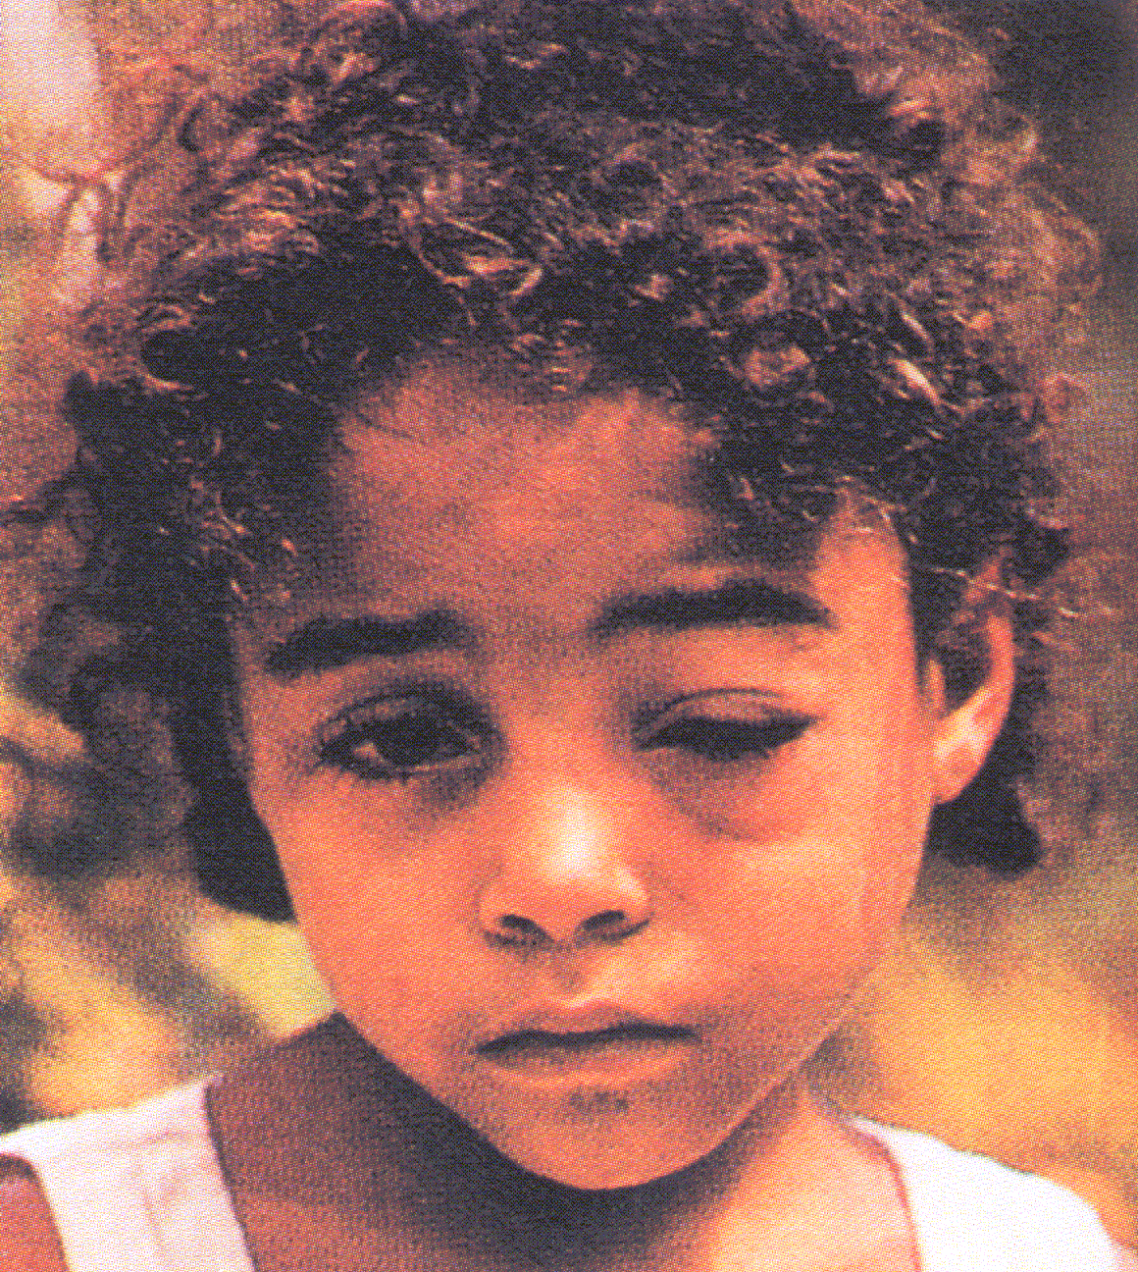
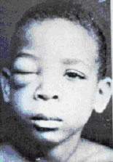
Acute Chagas’ disease (Cont.)
2- Romana's sign:
When chagoma occurs round the eye >>> unilateral conjunctivitis, edema of eye lids & cheek with ipsilateral prei-auricular lymphadenopathy.
3- Parasite reaches regional lymph node, blood, organs and tissues producing >>> fever, enlarged lymph nodes, skin rash, enlarged liver and spleen.
4- In severe infections >>> signs of meningoencephalitis and heart failure.
5- Death may occur or patient may recover or pass to chronic stage.

Slide 30
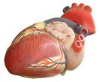
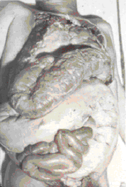
Chronic Chagas’ disease
Affects adults, may be asymptomatic or presenting with symptoms depend upon localization of the parasite.
Parasite attacks:
1- Oesophageal autonomic ganglia: >>> Mega-esophagus >>> dysphagia.
2- Colon autonomic ganglia: Megacolon >>> constipation.
3- Heart muscle fibers: ECG changes, congestive heart failure.
4- Less commonly CNS or thyroid gland involvement.
5- Exacerbation of infection in immunosuppressed patients (due to drugs or AIDS).

Slide 31
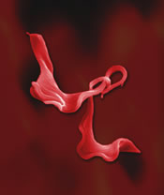
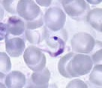
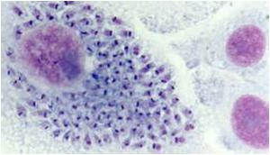
Diagnosis Clinical & Laboratory
Laboratory diagnosis
1- Blood film >>> C-shaped T. cruzi.
2- Biopsy from lymph node, liver or
spleen or muscle biopsy >>Amastigotes.
3- Culture on NNN>>> Epimastigotes.
4- Animal inoculation: Susceptible.

Slide 32
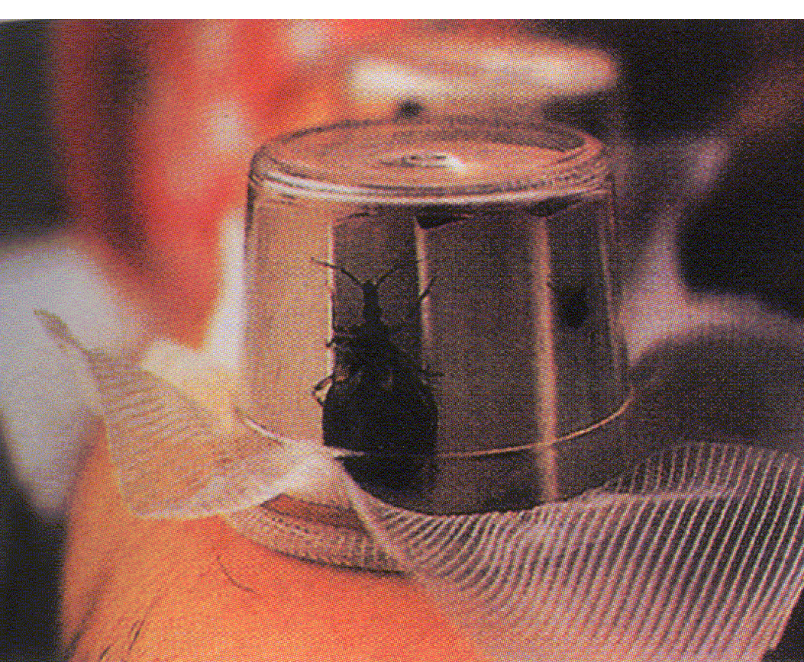
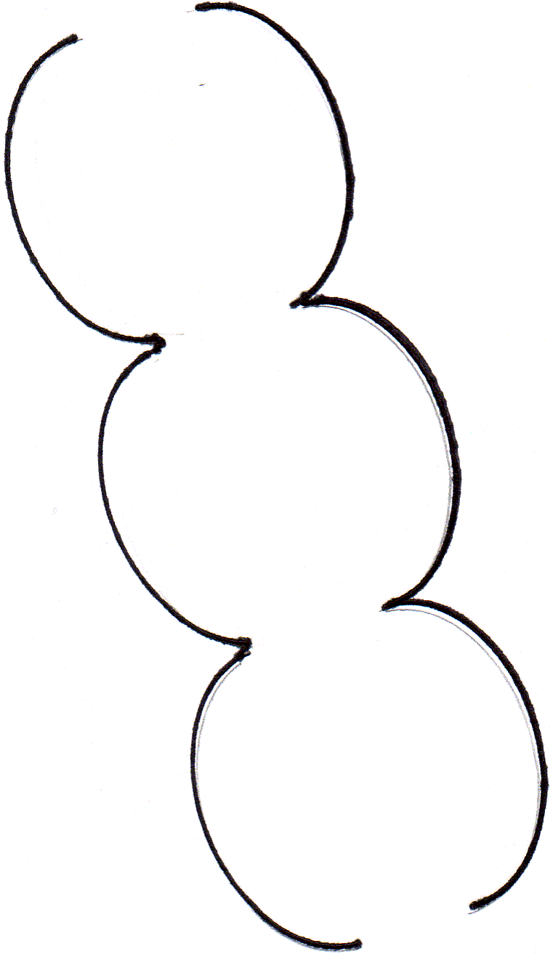
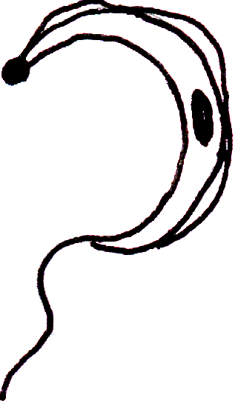
Diagnosis ===
5- Xenodiagnosis:
Highly efficient & demonstrates low level of parasite in blood.
Method: A Laboratory bred winged bug is starved for 2 weeks then fed on suspected patient’s blood. 30 days later, its faeces & gut are examined for the developmental stages of the parasite.
6- Serological tests: CFT, AFAT, IHAT.
7- Cruzin test:
Intradermal test gives a delayed reaction in +ve cases.
8- Molecular techniques: PCR.

Slide 33
Prevention & Control
Treatment
1-Primaquine orally (destroys trypomastigotes in blood and decreases tissue invasion).
2-Nifurtimox (Lampit): 8-10 mg/kg/day for two months. To inhibit intracellular development of T.cruzi:
Or
Benznidazole (Radanil): 5mg/kg/day for two months.
3- Symptomatic treatment.
Treatment of patients
Control of vectors (Triatoma)
Elimination of reservoir hosts.
Screening of blood donors.

